Slide 1
ANLY 5332
Department of Information Systems and Analytics
McCoy College of Business
Texas State University
Multi-objective Optimization and Goal Programming

Slide 2
Outline
Introduction and Solution Concepts
Single-objective Reduction
Pareto Front Generation
Epsilon-constraint Method Example
Goal Programming
  Weighted Goal Programming
  Preemptive Goal Programming

Slide 3
Outline
Introduction and Solution Concepts
Single-objective Reduction
Pareto Front Generation
Epsilon-constraint Method Example
Goal Programming
  Weighted Goal Programming
  Preemptive Goal Programming

Slide 4
Multi-objective Optimization
Many problems have multiple objectives:
  Planning the national budget
      save social security, reduce debt, cut taxes, build national defense
  Admitting students to college
      high SAT or GMAT, high GPA, diversity
  Planning an advertising campaign
      budget, reach, expenses, target groups
  Choosing taxation levels
      raise money, minimize tax burden on low-income, minimize flight of business
  Planning an investment portfolio
      maximize expected earnings, minimize risk
Optimization problems that involve multiple objectives
  Typically, conflicting objectives
  Formulation is just the same as regular models

Slide 5
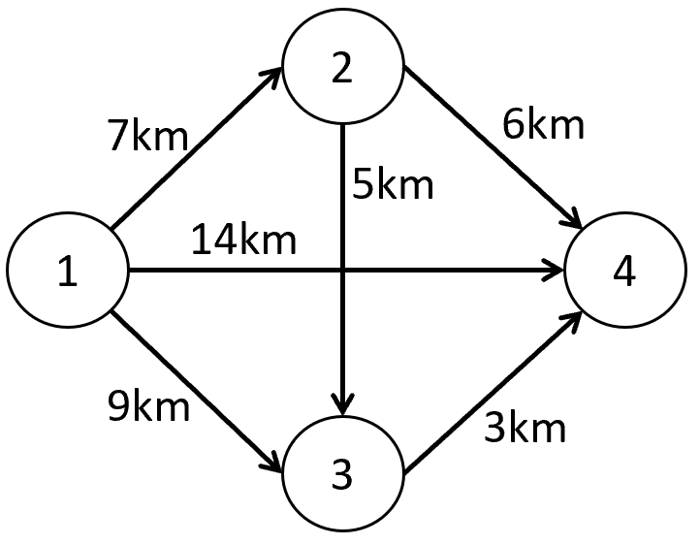
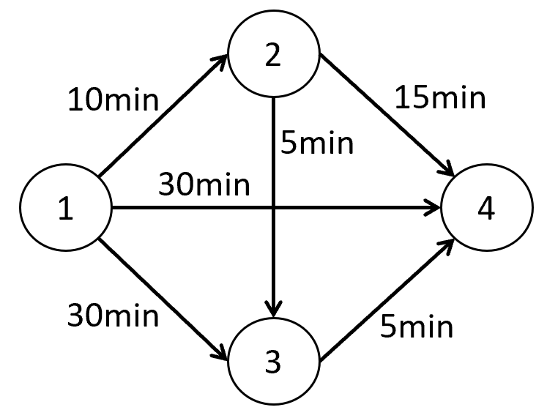
Multi-objective Optimization
Case: A multi-objective shortest path problem (not in the textbook):
Suppose that you want to go from node 1 to node 4.
  You want to minimize the total distance travelled
  You want to minimize the total travel time
    We already know how to formulate a single-objective shortest path problem
    Multi-objective (bi-objective in this case) formulation is similar
    We just need to include both objectives

Slide 6
Multi-objective Optimization
Case: A multi-objective shortest path problem (not in the textbook):
Suppose that you want to go from node 1 to node 4.
  You want to minimize the total distance travelled
  You want to minimize the total travel time
    Let X(i,j) denote the flow on arc (i,j). Then:
Minimize 7X_{(1,2)} + 9X_{(1,3)} +14X_{(1,4)} + 5X_{(2,3)} + 6X_{(2,4)} + 3X_{(3,4)}
Minimize 10X_{(1,2)} + 30X_{(1,3)} +30X_{(1,4)} + 5X_{(2,3)} + 15X_{(2,4)} + 5X_{(3,4)}
Subject to X_{(1,2)} + X_{(1,3)} + X_{(1,4)} =1
X_{(2,3)} + X_{(2,4)} - X_{(1,2)} =0
X_{(3,4)} - X_{(1,3)} - X_{(2,3)} =0
- X_{(1,4)} - X_{(2,4)} - X_{(3,4)} =-1
X(ij)>=0
1st objective
2nd objective
Flow-balance constraints (and nonnegativity)
Order of the objectives does not matter!

Slide 7
Multi-objective Optimization
For single-objective optimization models, we seek an optimum solution
  Optimum solution: A feasible solution such that there does not exist another feasible solution which is better in terms of the single objective function value!
For multi-objective optimization models, the optimum cannot be defined because of multiple objectives
  Based on each objective, we have an optimum solution
  An optimum solution for one objective is not necessarily optimum for the other objective(s)
Recall: A multi-objective shortest path problem (not in the textbook):
Shortest-distance path: 1→3→4 with 12 kms in total
Shortest-time path: 1→2→3→4 with 20 mins in total
See Bi-objective Shortest Path.xlsx

Slide 8
Multi-objective Optimization
Recall: A multi-objective shortest path problem (not in the textbook):
Closer look at the paths: we have 4 paths in total
  Path 1: 1→2→4 has 13 kms, takes 25 mins
  Path 2: 1→2→3→4 has 15 kms, takes 20 mins
  Path 3: 1→3→4 has 12 kms, takes 35 mins
  Path 4: 1→4 has 14 kms, takes 30 mins
Which path to select?
  Based on distance, select Path 3
  Based on time, select Path 2
  How about Path 1?
    It has more distance than Path 3, but it takes less time than Path 3
    It takes more time than Path 2, but it has less distance than Path 2
  How about Path 4?
    Well, Path 1 has less distance as well as less time than Path 4 does
So, not bad?
So, NO

Slide 9
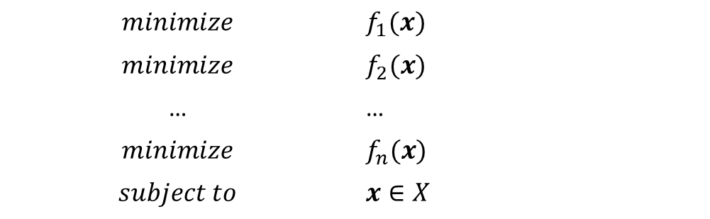
Solution Concepts
A generic formulation:
  𝒙: decision variables vector
  𝑓_{i}(𝒙): ith objective function, i=1,2,…,n
  X is the set of feasible solutions
    For linear programming model, for instance, X={x: Ax<=b, x>=0}
$$minimize$$ | $$f_{1}(x)$$
$$minimize$$ | $$f_{2}(x)$$
… | …
$$minimize$$ | $$f_{n}(x)$$
$$subject to$$ | $$x∈X$$

Slide 10
Solution Concepts
For multi-objective optimization models, we define Pareto efficient solutions
Pareto efficient solution: A feasible solution is Pareto efficient (Pareto optimum) if there does not exist another feasible solution that is better in terms of all objectives
  𝒙^{𝑎} is Pareto efficient if and only if ∄𝒙^{𝑏}∈𝑋 such that 𝑓𝑖 (𝒙^{𝑏} )≤𝑓𝑖 (𝒙^{𝑎} ) for all i=1,2,…,n and 𝑓𝑖 (𝒙^{𝑏} )<𝑓𝑖 (𝒙^{𝑎} ) for at least one i.
  This is also referred to as weak-Pareto efficiency
  If all “<=“ are replaced with “<“, then we have strong-Pareto efficiency
Property: Let 𝒙^{𝑖} be the unique optimum solution for the ith objective function, i.e., 𝒙^{𝑖} =𝑎𝑟𝑔𝑚𝑖𝑛{𝑓𝑖 (𝒙):𝒙∈𝑋}, then 𝒙^{𝑖} is Pareto efficient
  This is by definition… Since 𝒙^{𝑖} is the unique optimum solution for the ith objective function, there cannot be some other feasible solution that will be better than 𝒙^{𝑖} for the ith objective function. Thus, 𝒙^{𝑖} is a Pareto efficient solution.

Slide 11
Solution Concepts
Recall: A multi-objective shortest path problem (not in the textbook):
Closer look at the paths: we have 4 paths in total
  Path 1: 1→2→4 has 13 kms, takes 25 mins
  Path 2: 1→2→3→4 has 15 kms, takes 20 mins →Shortest-time path
  Path 3: 1→3→4 has 12 kms, takes 35 mins → Shortest-distance path
  Path 4: 1→4 has 14 kms, takes 30 mins
Path 3 is Pareto efficient as it is the unique optimum for 1st objective function (distance)
Path 2 is Pareto efficient as it is the unique optimum for 2nd objective function (time)
Path 1 is Pareto efficient
  There is no other path that has both less time and less distance than Path 1
Path 4 is not Pareto efficient
  Path 1 has less time and less distance than Path 4 does
  Path 1 Pareto dominates Path 4

Slide 12
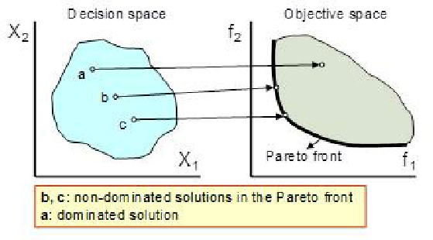
Solution Concepts
Non-dominated Point vs. Pareto efficient solution
  A non-dominated point is the point defined by the objective function values of a Pareto efficient solution
  It is possible that several Pareto efficient solutions correspond to the same non-dominated point
  Pareto Front is the set of non-dominated points

Slide 13
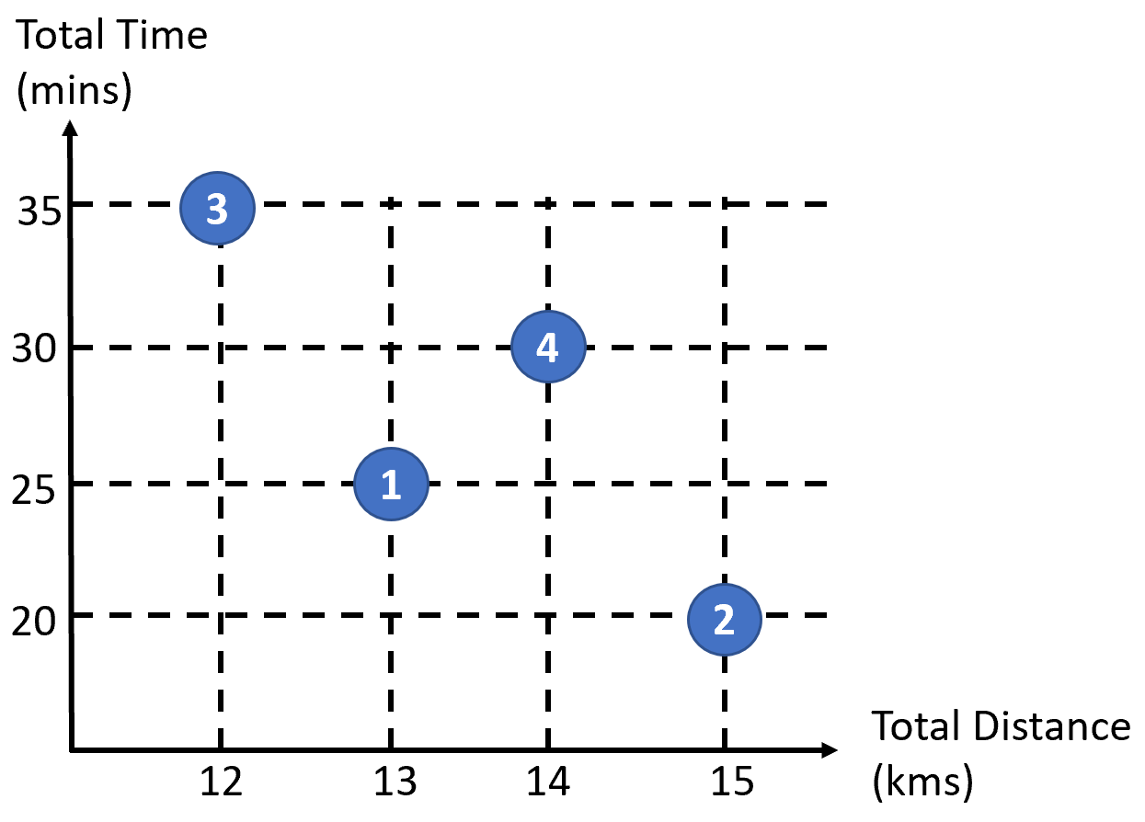
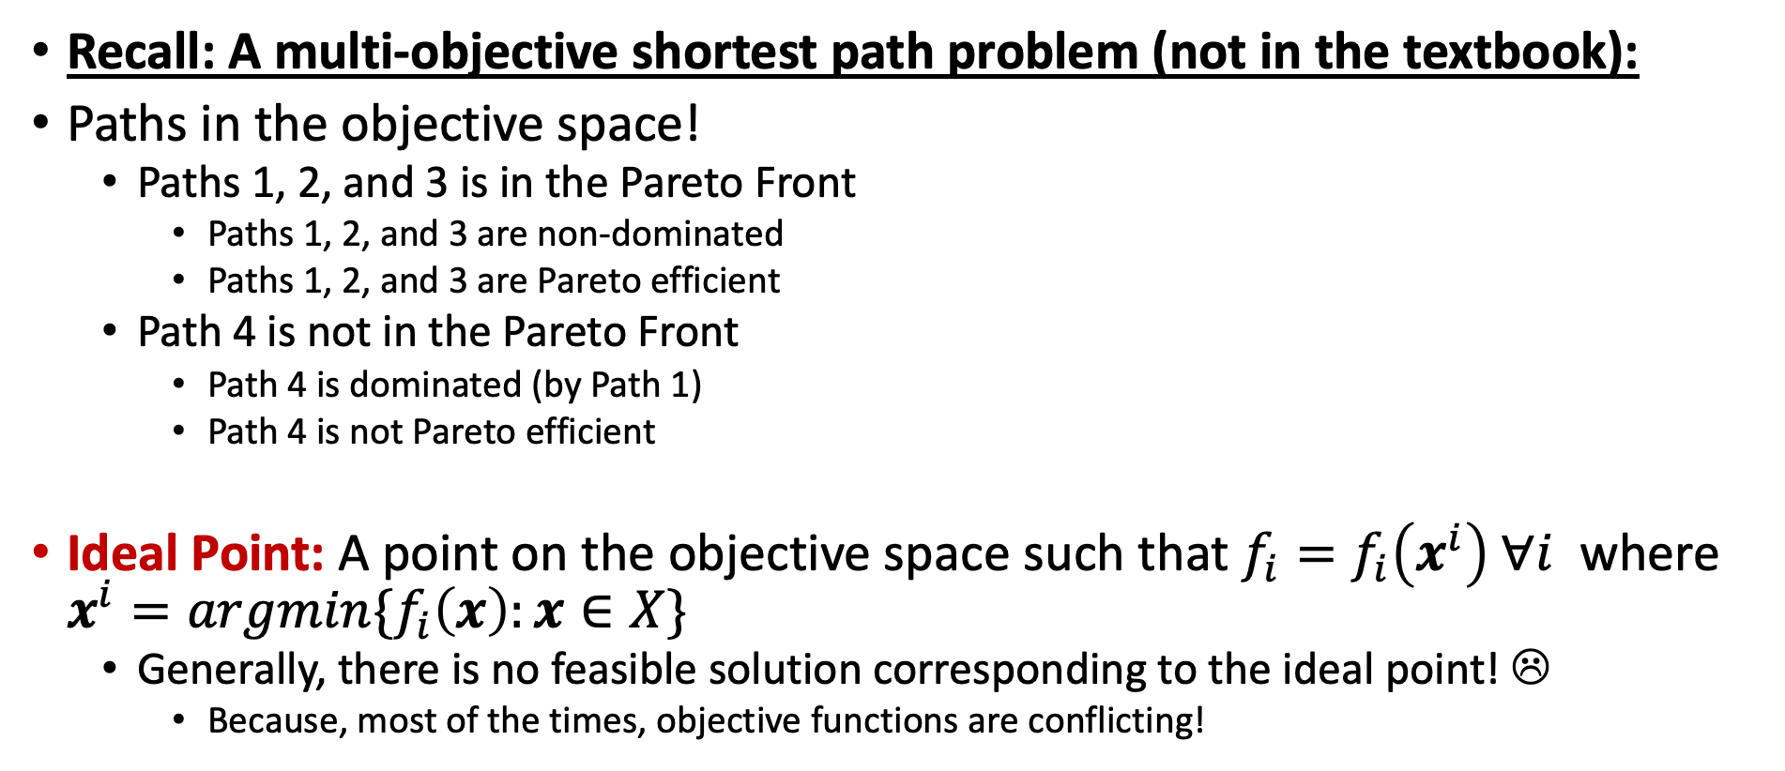
Solution Concepts
Recall: A multi-objective shortest path problem (not in the textbook):
Paths in the objective space!
  Paths 1, 2, and 3 is in the Pareto Front
    Paths 1, 2, and 3 are non-dominated
    Paths 1, 2, and 3 are Pareto efficient
  Path 4 is not in the Pareto Front
    Path 4 is dominated (by Path 1)
    Path 4 is not Pareto efficient
Ideal Point: A point on the objective space such that $f_{i}=f_{i}\left(x^{i}\right) ∀i$ where $x^{i}=argmin\{f_{i}\left(x\right):x∈X\}$
  Generally, there is no feasible solution corresponding to the ideal point! ☹
    Because, most of the times, objective functions are conflicting!
Ideal Point

Slide 14
Solution Concepts
Two main solution concepts for multi-objective optimization problems
  Reduction to Single-Objective Model
    Represent the problem as a single objective model
    Find the optimum solution for the resulting single-objective optimization problem
    How to get the single objective function?
  Pareto front Generation
    Generate all (or most) of the Pareto efficient solutions
    Might be challenging!
    Also, returns multiple solutions, and the decision maker might still need to select one solution!

Slide 15
Outline
Introduction and Solution Concepts
Single-objective Reduction
Pareto Front Generation
Epsilon-constraint Method Example
Goal Programming
  Weighted Goal Programming
  Preemptive Goal Programming

Slide 16
Reduction to Single-Objective
The idea is to convert the multi-objective model into a single-objective model, and find the optimum solution for this single-objective model
  Ultimately, the decision maker might seek to get one solution to implement
There are different ways to reduce a multi-objective model to a single-objective model
  Supervised methods: The decision maker plays an active role in how the different objectives are combined into a single objective function
    Typically, ranking (weighting) methods are supervised methods
  Unsupervised methods: The decision maker does not directly intervene in reducing the multi-objective model into a single-objective one

Slide 17
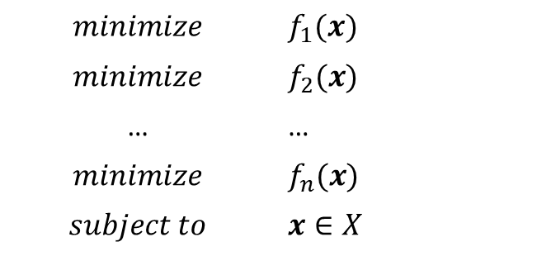
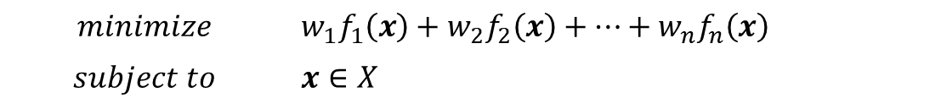
Supervised Methods
Supervised methods: The decision maker plays an active role in how the different objectives are combined into a single objective function
  Goal programming: focus deviations of the objectives from defined goals (weighted or preemptive)
  Ranking/weighting approach: The decision maker ranks the objectives based on expertise, needs, importance…
  Points to be careful: When the objective functions have different units (say time vs. distance), you cannot just get a meaningful single-objective function as the weighted sum of the objective functions (e.g., time+cost is not meaningful)
$$minimize$$ | $$f_{1}(x)$$
$$minimize$$ | $$f_{2}(x)$$
… | …
$$minimize$$ | $$f_{n}(x)$$
$$subject to$$ | $$x∈X$$
$$minimize$$ | $${w_{1}f}_{1}\left(x\right)+w_{2}f_{2}\left(x\right)+…+w_{n}f_{n}\left(x\right)$$
$$subject to$$ | $$x∈X$$

Slide 18

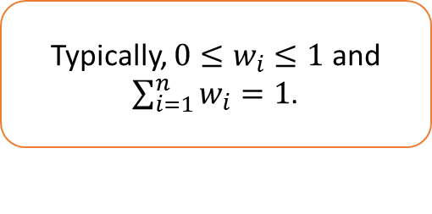
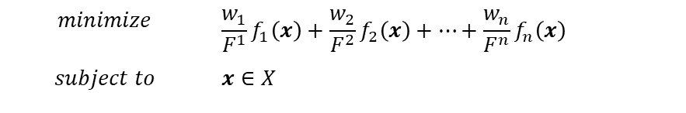
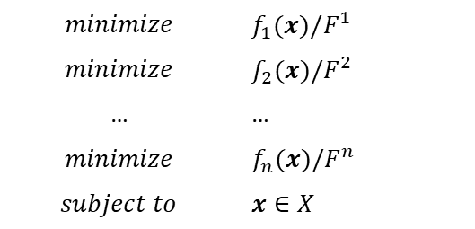
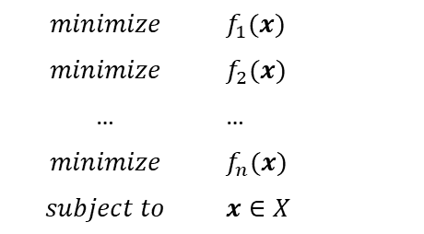
Supervised Methods
Supervised methods: The decision maker plays an active role in how the different objectives are combined into a single objective function
  Use normalized weighting approach!
    Let $F^{i}=min\{f_{i}\left(x\right):x∈X\}$, i.e., $F^{i}$ is the optimum objective function value objective $i$
$$minimize$$ | $$f_{1}(x)$$
$$minimize$$ | $$f_{2}(x)$$
… | …
$$minimize$$ | $$f_{n}(x)$$
$$subject to$$ | $$x∈X$$
$$minimize$$ | $$f_{1}(x)/F^{1}$$
$$minimize$$ | $$f_{2}(x)/F^{2}$$
… | …
$$minimize$$ | $$f_{n}(x)/F^{n}$$
$$subject to$$ | $$x∈X$$
$$minimize$$ | $${\frac{w_{1}}{F^{1}}f}_{1}\left(x\right)+\frac{w_{2}}{F^{2}}f_{2}\left(x\right)+…+\frac{w_{n}}{F^{n}}f_{n}\left(x\right)$$
$$subject to$$ | $$x∈X$$
Typically, ${0≤w}_{i}≤1$ and $\sum_{i=1}^{n}{w_{i}=1}$.
Normalization
Weighting

Slide 19

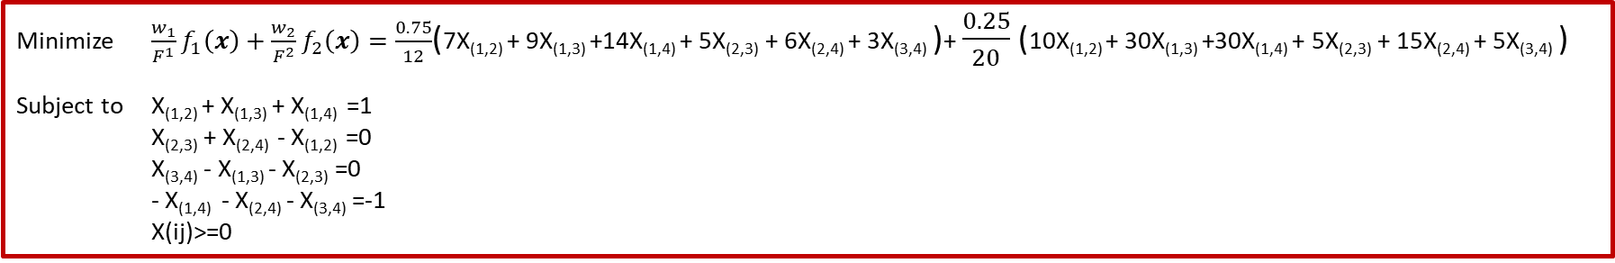
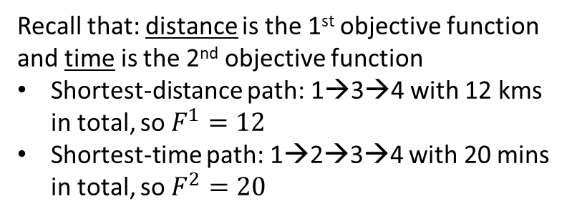
Supervised Methods
Recall: A multi-objective shortest path problem (not in the textbook):
  Say, distance is more important than time (but we are not totally ignoring time), therefore, let’s say $w_{1}=0.75$ (weight for distance) and $w_{2}=0.25$ (weight for time)
Minimize f₁(X)=7X_{(1,2)} + 9X_{(1,3)} +14X_{(1,4)} + 5X_{(2,3)} + 6X_{(2,4)} + 3X_{(3,4)}
Minimize f₂(X)= 10X_{(1,2)} + 30X_{(1,3)} +30X_{(1,4)} + 5X_{(2,3)} + 15X_{(2,4)} + 5X_{(3,4)}
Subject to X_{(1,2)} + X_{(1,3)} + X_{(1,4)} =1
X_{(2,3)} + X_{(2,4)} - X_{(1,2)} =0
X_{(3,4)} - X_{(1,3)} - X_{(2,3)} =0
- X_{(1,4)} - X_{(2,4)} - X_{(3,4)} =-1
X(ij)>=0
Recall that: distance is the 1st objective function and time is the 2nd objective function
Shortest-distance path: 1→3→4 with 12 kms in total, so $F^{1}=12$
Shortest-time path: 1→2→3→4 with 20 mins in total, so $F^{2}=20$
Minimize ${\frac{w_{1}}{F^{1}}f}_{1}\left(x\right)+\frac{w_{2}}{F^{2}}f_{2}\left(x\right)=\frac{0.75}{12}$(7X_{(1,2)} + 9X_{(1,3)} +14X_{(1,4)} + 5X_{(2,3)} + 6X_{(2,4)} + 3X_{(3,4)} )+ $\frac{0.25}{20}$(10X_{(1,2)} + 30X_{(1,3)} +30X_{(1,4)} + 5X_{(2,3)} + 15X_{(2,4)} + 5X_{(3,4)} )
Subject to X_{(1,2)} + X_{(1,3)} + X_{(1,4)} =1
X_{(2,3)} + X_{(2,4)} - X_{(1,2)} =0
X_{(3,4)} - X_{(1,3)} - X_{(2,3)} =0
- X_{(1,4)} - X_{(2,4)} - X_{(3,4)} =-1
X(ij)>=0
The optimum solution for this single-objective shortest-path problem is:
Path 1: 1→2→4
See Bi-objective Shortest Path.xlsx

Slide 20
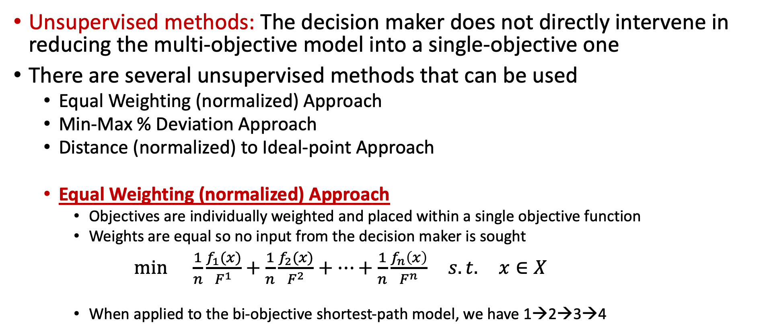
Unsupervised Methods
Unsupervised methods: The decision maker does not directly intervene in reducing the multi-objective model into a single-objective one
There are several unsupervised methods that can be used
  Equal Weighting (normalized) Approach
  Min-Max % Deviation Approach
  Distance (normalized) to Ideal-point Approach
  Equal Weighting (normalized) Approach
    Objectives are individually weighted and placed within a single objective function
    Weights are equal so no input from the decision maker is sought
$\min{ \frac{1}{n}\frac{f_{1}(x)}{F^{1}}+\frac{1}{n}\frac{f_{2}(x)}{F^{2}}+…+\frac{1}{n}\frac{f_{n}\left(x\right)}{F^{n}} s.t. x∈X}$
    When applied to the bi-objective shortest-path model, we have 1→2→3→4

Slide 21
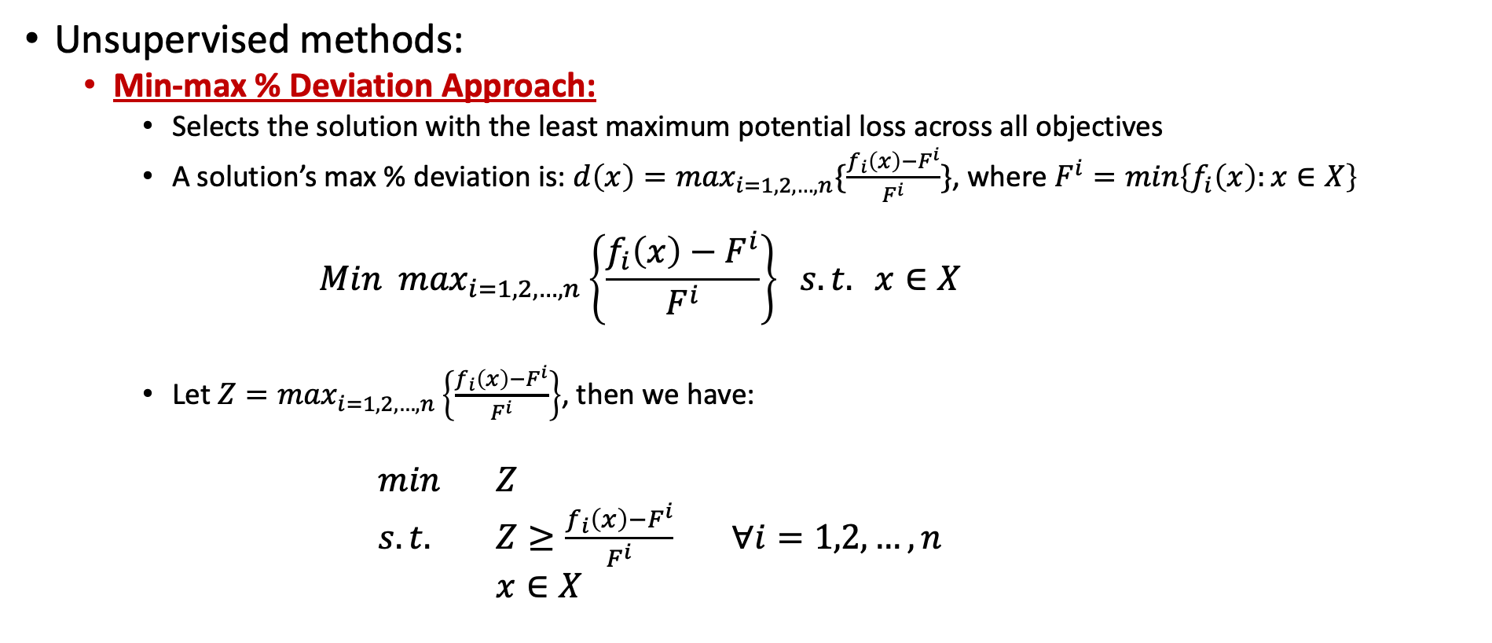
Unsupervised Methods
Unsupervised methods:
  Min-max % Deviation Approach:
    Selects the solution with the least maximum potential loss across all objectives
    A solution’s max % deviation is: ${d\left(x\right)=max}_{i=1,2,…,n}\{\frac{f_{i}\left(x\right)−F^{i}}{F^{i}}\}$, where $F^{i}=min\left\{f_{i}\left(x\right):x∈X\right\}$
          $$Min\max_{i=1,2,…,n}\left\{\frac{f_{i}\left(x\right)−F^{i}}{F^{i}}\right\} s.t. x∈X$$
    Let $Z=\max_{i=1,2,…,n}\left\{\frac{f_{i}\left(x\right)−F^{i}}{F^{i}}\right\}$, then we have:
            $min$ $Z$
            $s.t.$ $Z≥\frac{f_{i}\left(x\right)−F^{i}}{F^{i}}$ $∀i=1,2,…,n$
            $x∈X$

Slide 22
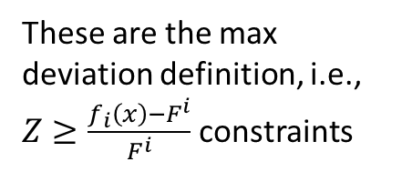
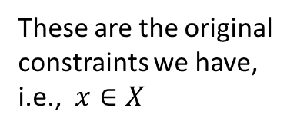
Unsupervised Methods
Unsupervised methods:
  Min-max % Deviation Approach:
  Recall: A multi-objective shortest path problem (not in the textbook):
Minimize f₁(X)=7X_{(1,2)} + 9X_{(1,3)} +14X_{(1,4)} + 5X_{(2,3)} + 6X_{(2,4)} + 3X_{(3,4)}
Minimize f₂(X)= 10X_{(1,2)} + 30X_{(1,3)} +30X_{(1,4)} + 5X_{(2,3)} + 15X_{(2,4)} + 5X_{(3,4)}
Subject to X_{(1,2)} + X_{(1,3)} + X_{(1,4)} =1
X_{(2,3)} + X_{(2,4)} - X_{(1,2)} =0
X_{(3,4)} - X_{(1,3)} - X_{(2,3)} =0
- X_{(1,4)} - X_{(2,4)} - X_{(3,4)} =-1
X(ij)>=0
Minimize Z
Subject to Z>=(7X_{(1,2)} + 9X_{(1,3)} +14X_{(1,4)} + 5X_{(2,3)} + 6X_{(2,4)} + 3X_{(3,4)} -12)/12
Z>=(10X_{(1,2)} + 30X_{(1,3)} +30X_{(1,4)} + 5X_{(2,3)} + 15X_{(2,4)} + 5X_{(3,4)} -20)/20
X_{(1,2)} + X_{(1,3)} + X_{(1,4)} =1
X_{(2,3)} + X_{(2,4)} - X_{(1,2)} =0
X_{(3,4)} - X_{(1,3)} - X_{(2,3)} =0
- X_{(1,4)} - X_{(2,4)} - X_{(3,4)} =-1
X(ij) binary!
These are the max deviation definition, i.e., $Z≥\frac{f_{i}\left(x\right)−F^{i}}{F^{i}}$ constraints
These are the original constraints we have, i.e.,$x∈X$
The optimum solution for this min-max % deviation problem is: Path 1: 1→2→4
See Bi-objective Shortest Path.xlsx

Slide 23
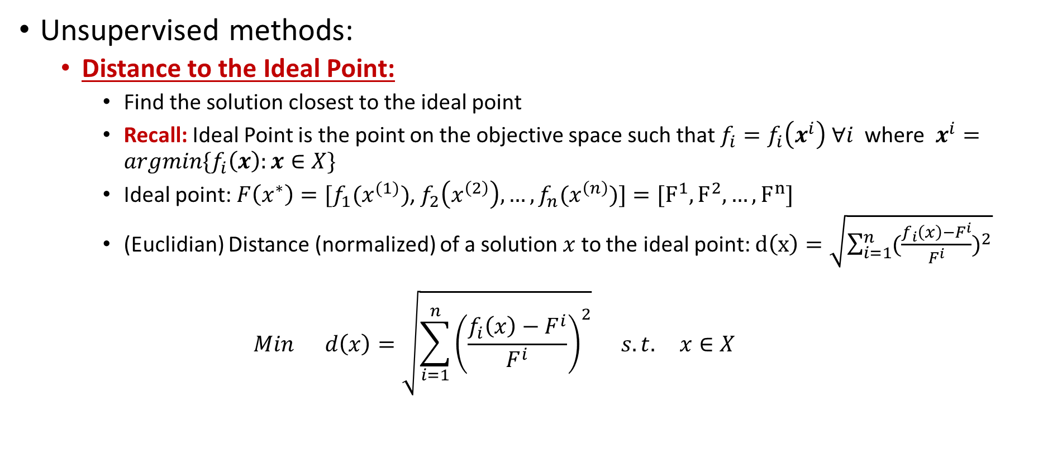
Unsupervised Methods
Unsupervised methods:
  Distance to the Ideal Point:
    Find the solution closest to the ideal point
    Recall: Ideal Point is the point on the objective space such that $f_{i}=f_{i}\left(x^{i}\right) ∀i$ where $x^{i}=argmin\{f_{i}\left(x\right):x∈X\}$
    Ideal point: $F\left(x^{∗}\right)=[f_{1}(x^{(1)})$, $f_{2}\left(x^{\left(2\right)}\right),…,f_{n}(x^{\left(n\right)})]=[F^{1},F^{2},…,F^{n}]$
    (Euclidian) Distance (normalized) of a solution $x$ to the ideal point: $d\left(x\right)=\sqrt{\sum_{i=1}^{n}{{(\frac{f_{i}\left(x\right)−F^{i}}{F^{i}})}^{2}}}$
    $$Min d\left(x\right)=\sqrt{\sum_{i=1}^{n}{{\left(\frac{f_{i}\left(x\right)−F^{i}}{F^{i}}\right)}^{2}}} s.t. x∈X$$

Slide 24
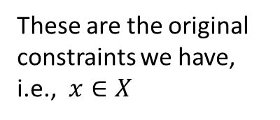
Unsupervised Methods
Unsupervised methods:
  Distance to the Ideal Point :
  Recall: A multi-objective shortest path problem (not in the textbook):
Minimize f₁(X)=7X_{(1,2)} + 9X_{(1,3)} +14X_{(1,4)} + 5X_{(2,3)} + 6X_{(2,4)} + 3X_{(3,4)}
Minimize f₂(X)= 10X_{(1,2)} + 30X_{(1,3)} +30X_{(1,4)} + 5X_{(2,3)} + 15X_{(2,4)} + 5X_{(3,4)}
Subject to X_{(1,2)} + X_{(1,3)} + X_{(1,4)} =1
X_{(2,3)} + X_{(2,4)} - X_{(1,2)} =0
X_{(3,4)} - X_{(1,3)} - X_{(2,3)} =0
- X_{(1,4)} - X_{(2,4)} - X_{(3,4)} =-1
X(ij)>=0
Minimize d(X)={[(7X_{(1,2)} + 9X_{(1,3)} +14X_{(1,4)} + 5X_{(2,3)} + 6X_{(2,4)} + 3X_{(3,4)} -12)/12]² +[(10X_{(1,2)} + 30X_{(1,3)} +30X_{(1,4)} + 5X_{(2,3)} + 15X_{(2,4)} + 5X_{(3,4)} -20)/ 20]²}^{0.5}
Subject to X_{(1,2)} + X_{(1,3)} + X_{(1,4)} =1
X_{(2,3)} + X_{(2,4)} - X_{(1,2)} =0
X_{(3,4)} - X_{(1,3)} - X_{(2,3)} =0
- X_{(1,4)} - X_{(2,4)} - X_{(3,4)} =-1
X(ij) binary!
Distance to the ideal point
These are the original constraints we have, i.e.,$x∈X$
The optimum solution for this distance-to-ideal point problem is: Path 2: 1→2→3→4
See Bi-objective Shortest Path.xlsx

Slide 25
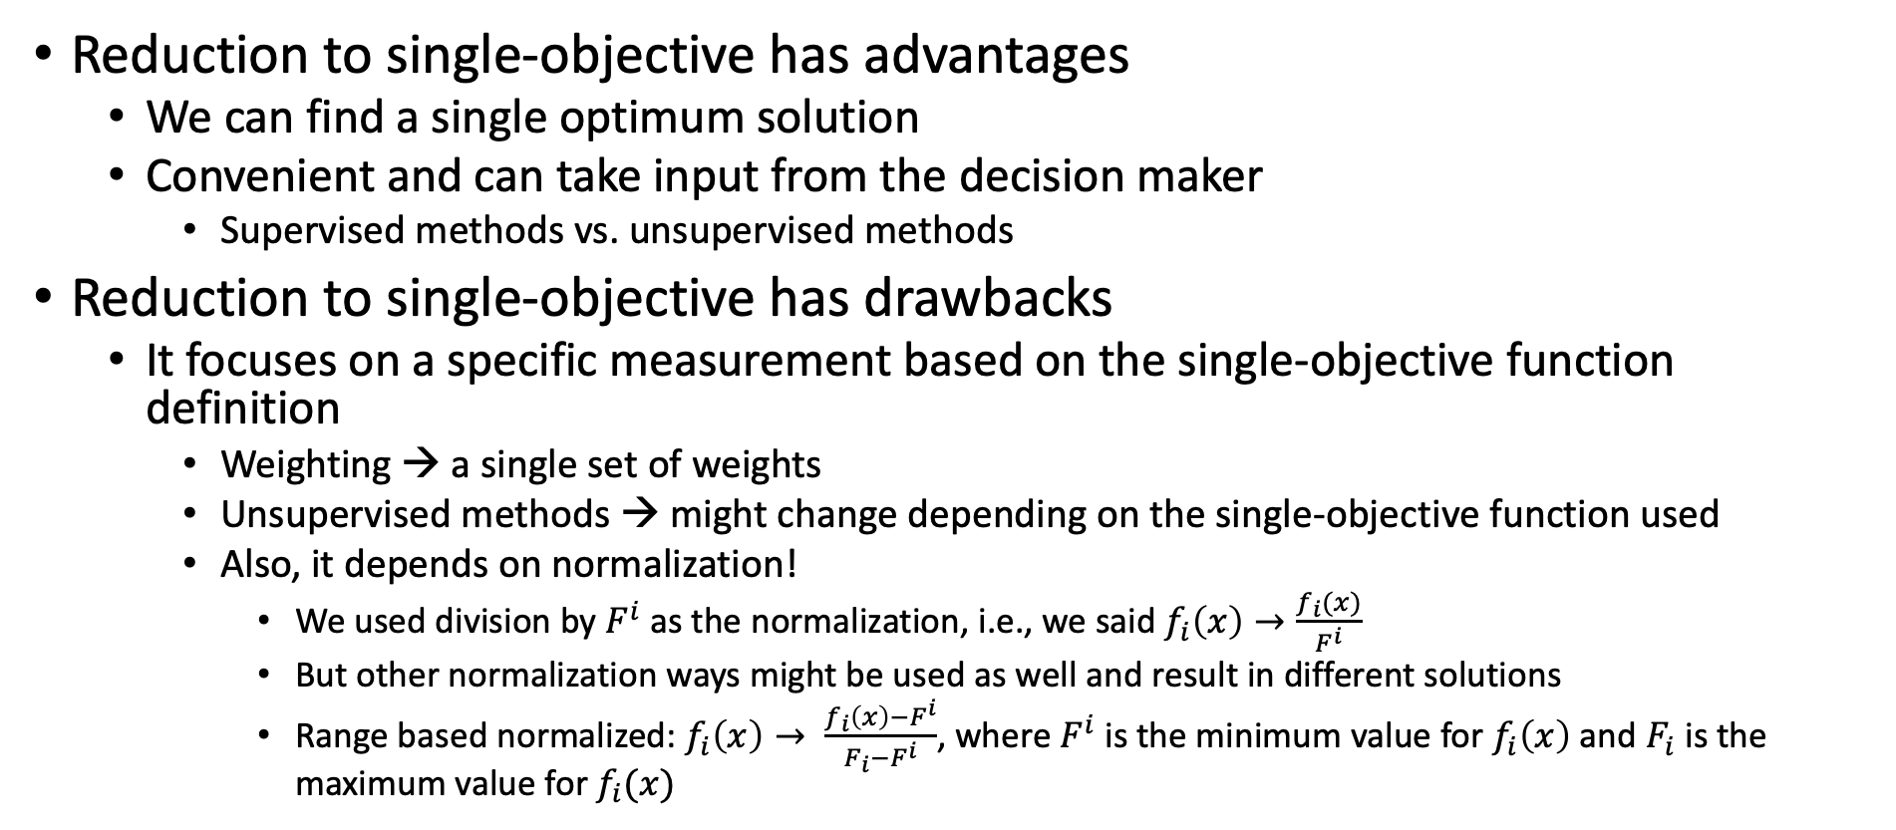
Reduction to Single-Objective
Reduction to single-objective has advantages
  We can find a single optimum solution
  Convenient and can take input from the decision maker
    Supervised methods vs. unsupervised methods
Reduction to single-objective has drawbacks
  It focuses on a specific measurement based on the single-objective function definition
    Weighting → a single set of weights
    Unsupervised methods → might change depending on the single-objective function used
    Also, it depends on normalization!
      We used division by $F^{i}$ as the normalization, i.e., we said $f_{i}\left(x\right)→\frac{f_{i}(x)}{F^{i}}$
      But other normalization ways might be used as well and result in different solutions
      Range based normalized: $f_{i}\left(x\right)→ \frac{f_{i}\left(x\right)−F^{i}}{F_{i}−F^{i}}$, where $F^{i}$ is the minimum value for $f_{i}\left(x\right)$ and $F_{i}$ is the maximum value for $f_{i}(x)$

Slide 26
Outline
Introduction and Solution Concepts
Single-objective Reduction
Pareto Front Generation
Epsilon-constraint Method Example
Goal Programming
  Weighted Goal Programming
  Preemptive Goal Programming

Slide 27
Pareto Front Generation
Pareto Front generation aims to generate all of the Pareto efficient solutions
  Recall that: A feasible solution is Pareto efficient (Pareto optimum) if there does not exist another feasible solution that is better in terms of all objectives
  Pareto Front approximation: Instead of generating all Pareto efficient solutions, generate some of them, or generate solutions close to Pareto efficient solutions
Pareto Front typically includes multiple solutions
  The decision maker can select one of them to implement
  Demonstrates the trade-offs, i.e., the Pareto front
The issues:
  How to determine the Pareto efficient solutions effectively
  How to generate (or approximate) the Pareto front
  How good an approximation is compared to the exact Pareto front

Slide 28
Pareto Front Generation
The simplest case: two objectives
  When we have two objectives, we have a bi-objective optimization problem
  Depending on the type of the model, Pareto Front can be continuous or discrete
    For a continuous model, the Pareto Front can be a continuous curve
    For a discrete (pure integer/binary variables), the Pareto front can be a discrete set
Epsilon-constraint method: It is the most well-known and most straight-forward method to generate Pareto efficient solutions
  It is an approximation method for continuous models
    For continuous models, the Pareto front can be a continuous set (or combination of continuous sets), so, it is not possible to generate all of them
  It can be an exact method for integer models
    Just might need to make all parameters of the objective function integer

Slide 29
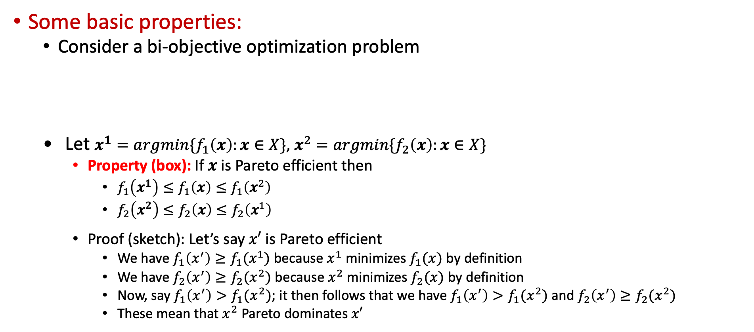
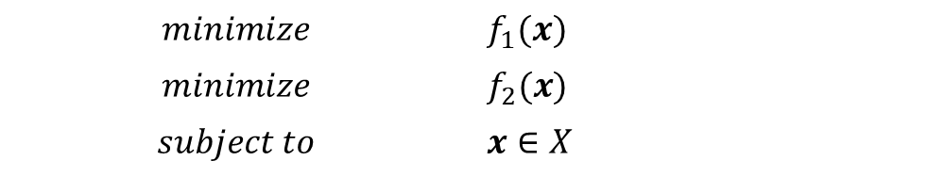
Epsilon-Constraint Method
Some basic properties:
  Consider a bi-objective optimization problem
    Let $x^{1}=argmin\{f_{1}\left(x\right):x∈X\}$, $x^{2}=argmin\{f_{2}\left(x\right):x∈X\}$
    Property (box): If $x$ is Pareto efficient then
      $f_{1}\left(x^{1}\right)≤f_{1}\left(x\right)≤f_{1}\left(x^{2}\right)$
      $f_{2}\left(x^{2}\right)≤f_{2}\left(x\right)≤f_{2}\left(x^{1}\right)$
    Proof (sketch): Let’s say $x′$ is Pareto efficient
      We have $f_{1}\left(x^{′}\right)≥f_{1}(x^{1})$ because $x^{1}$ minimizes $f_{1}(x)$ by definition
      We have $f_{2}\left(x^{′}\right)≥f_{2}(x^{2})$ because $x^{2}$ minimizes $f_{2}(x)$ by definition
      Now, say $f_{1}\left(x^{′}\right)>f_{1}(x^{2})$; it then follows that we have $f_{1}\left(x^{′}\right)>f_{1}(x^{2})$ and $f_{2}\left(x^{′}\right)≥f_{2}(x^{2})$
      These mean that $x^{2}$ Pareto dominates $x′$
$$minimize$$ | $$f_{1}(x)$$
$$minimize$$ | $$f_{2}(x)$$
$$subject to$$ | $$x∈X$$

Slide 30
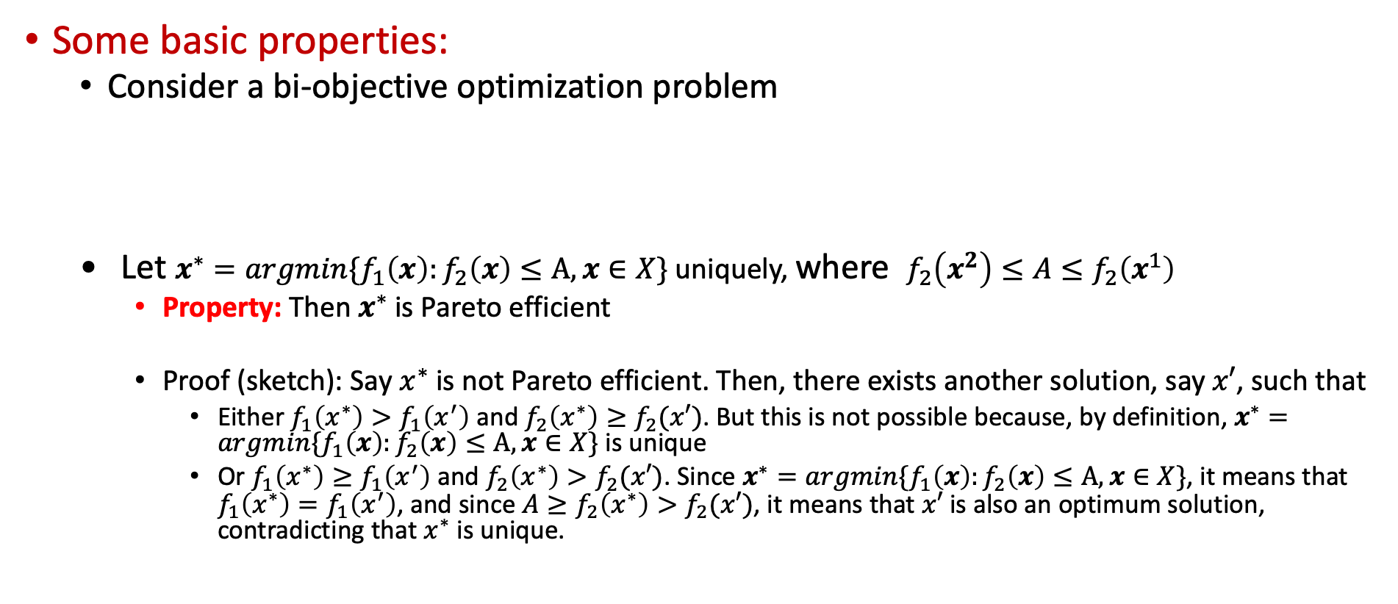
Epsilon-Constraint Method
Some basic properties:
  Consider a bi-objective optimization problem
    Let $x^{∗}=argmin\{f_{1}\left(x\right):f_{2}\left(x\right)≤A,x∈X\}$ uniquely, where $f_{2}\left(x^{2}\right)≤A≤f_{2}\left(x^{1}\right)$
    Property: Then $x^{∗}$ is Pareto efficient
    Proof (sketch): Say $x^{∗}$ is not Pareto efficient. Then, there exists another solution, say $x′$, such that
      Either $f_{1}\left(x^{∗}\right)>f_{1}\left(x^{′}\right)$ and $f_{2}\left(x^{∗}\right)≥f_{2}(x′)$. But this is not possible because, by definition, $x^{∗}=argmin\{f_{1}\left(x\right):f_{2}\left(x\right)≤A,x∈X\}$ is unique
      Or $f_{1}\left(x^{∗}\right)≥f_{1}\left(x^{′}\right)$ and $f_{2}\left(x^{∗}\right)>f_{2}(x′)$. Since $x^{∗}=argmin\{f_{1}\left(x\right):f_{2}\left(x\right)≤A,x∈X\}$, it means that $f_{1}\left(x^{∗}\right)=f_{1}\left(x^{′}\right)$, and since ${A≥f}_{2}\left(x^{∗}\right)>f_{2}(x′)$, it means that $x′$ is also an optimum solution, contradicting that $x^{∗}$ is unique.
$$minimize$$ | $$f_{1}(x)$$
$$minimize$$ | $$f_{2}(x)$$
$$subject to$$ | $$x∈X$$

Slide 31
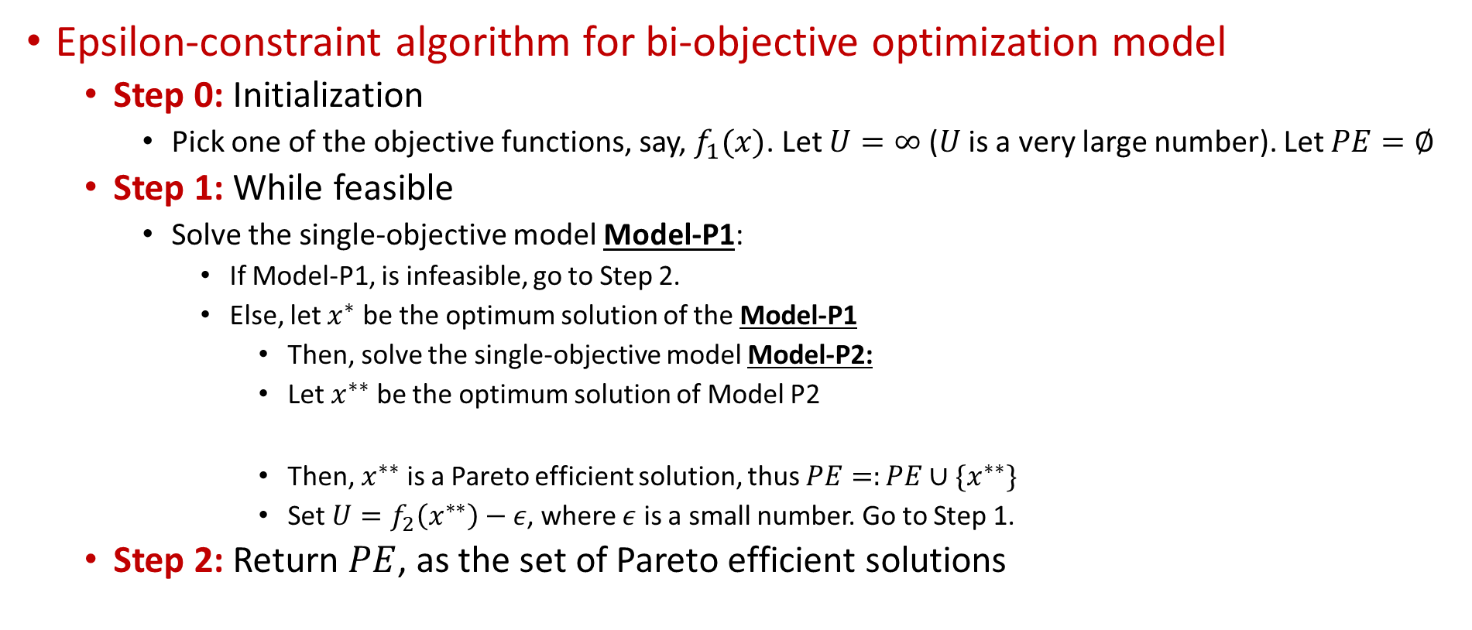
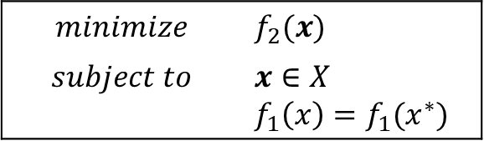
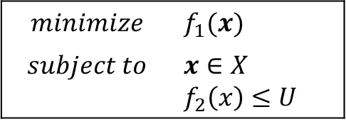
Epsilon-Constraint Method
Epsilon-constraint algorithm for bi-objective optimization model
  Step 0: Initialization
    Pick one of the objective functions, say, $f_{1}(x)$. Let $U=∞$ ($U$ is a very large number). Let $PE=∅$
  Step 1: While feasible
    Solve the single-objective model Model-P1:
      If Model-P1, is infeasible, go to Step 2.
      Else, let $x^{∗}$ be the optimum solution of the Model-P1
        Then, solve the single-objective model Model-P2:
        Let $x^{∗∗}$ be the optimum solution of Model P2
        Then, $x^{∗∗}$ is a Pareto efficient solution, thus $PE=:PE∪\{x^{∗∗}\}$
        Set $U=f_{2}\left(x^{∗∗}\right)−ε$, where $ε$ is a small number. Go to Step 1.
  Step 2: Return $PE$, as the set of Pareto efficient solutions
$$minimize$$ | $$f_{1}(x)$$
$$subject to$$ | $$x∈X$$ $$f_{2}\left(x\right)≤U$$
$$minimize$$ | $$f_{2}(x)$$
$$subject to$$ | $$x∈X$$ $$f_{1}\left(x\right)=f_{1}(x^{∗})$$
Solving Model-P2 is not needed if you know that Model-P1 has unique optimum solution!

Slide 32
Outline
Introduction and Solution Concepts
Single-objective Reduction
Pareto Front Generation
Epsilon-constraint Method Example
Goal Programming
  Weighted Goal Programming
  Preemptive Goal Programming

Slide 33

Epsilon-Constraint Method: Example
Recall: A multi-objective shortest path problem (not in the textbook):
  Step 0: Initialization
    Pick one of the objective functions, say, $f_{1}(x)$.
    Let $U=1000$ ($U$ is a very large number).
    Let $PE=∅$
Minimize f₁(X)=7X_{(1,2)} + 9X_{(1,3)} +14X_{(1,4)} + 5X_{(2,3)} + 6X_{(2,4)} + 3X_{(3,4)}
Minimize f₂(X)= 10X_{(1,2)} + 30X_{(1,3)} +30X_{(1,4)} + 5X_{(2,3)} + 15X_{(2,4)} + 5X_{(3,4)}
Subject to X_{(1,2)} + X_{(1,3)} + X_{(1,4)} =1
X_{(2,3)} + X_{(2,4)} - X_{(1,2)} =0
X_{(3,4)} - X_{(1,3)} - X_{(2,3)} =0
- X_{(1,4)} - X_{(2,4)} - X_{(3,4)} =-1
X(ij)>=0

Slide 34
Epsilon-Constraint Method: Example
Recall: A multi-objective shortest path problem (not in the textbook):
  Step 1: While feasible
Minimize f₁(X)=7X_{(1,2)} + 9X_{(1,3)} +14X_{(1,4)} + 5X_{(2,3)} + 6X_{(2,4)} + 3X_{(3,4)}
Subject to f₂(X)= 10X_{(1,2)} + 30X_{(1,3)} +30X_{(1,4)} + 5X_{(2,3)} + 15X_{(2,4)} + 5X_{(3,4)} <=1000
X_{(1,2)} + X_{(1,3)} + X_{(1,4)} =1
X_{(2,3)} + X_{(2,4)} - X_{(1,2)} =0
X_{(3,4)} - X_{(1,3)} - X_{(2,3)} =0
- X_{(1,4)} - X_{(2,4)} - X_{(3,4)} =-1
X(ij) binary
Model P1:
X* is Path 3 with f₁(X*)=12
Minimize f₂(X)= 10X_{(1,2)} + 30X_{(1,3)} +30X_{(1,4)} + 5X_{(2,3)} + 15X_{(2,4)} + 5X_{(3,4)}
Subject to f₁(X)=7X_{(1,2)} + 9X_{(1,3)} +14X_{(1,4)} + 5X_{(2,3)} + 6X_{(2,4)} + 3X_{(3,4)} =12
X_{(1,2)} + X_{(1,3)} + X_{(1,4)} =1
X_{(2,3)} + X_{(2,4)} - X_{(1,2)} =0
X_{(3,4)} - X_{(1,3)} - X_{(2,3)} =0
- X_{(1,4)} - X_{(2,4)} - X_{(3,4)} =-1
X(ij) binary
Model P2:
X** is Path 3 with f₁(X**)=12 and f₂(X**)=35
So, PE=PE U {X**} or
PE={Path-3}
Make U=35-1=34

Slide 35
Epsilon-Constraint Method: Example
Recall: A multi-objective shortest path problem (not in the textbook):
  Step 1: While feasible
Minimize f₁(X)=7X_{(1,2)} + 9X_{(1,3)} +14X_{(1,4)} + 5X_{(2,3)} + 6X_{(2,4)} + 3X_{(3,4)}
Subject to f₂(X)= 10X_{(1,2)} + 30X_{(1,3)} +30X_{(1,4)} + 5X_{(2,3)} + 15X_{(2,4)} + 5X_{(3,4)} <=34
X_{(1,2)} + X_{(1,3)} + X_{(1,4)} =1
X_{(2,3)} + X_{(2,4)} - X_{(1,2)} =0
X_{(3,4)} - X_{(1,3)} - X_{(2,3)} =0
- X_{(1,4)} - X_{(2,4)} - X_{(3,4)} =-1
X(ij) binary
Model P1:
X* is Path 1 with f₁(X*)=13
Minimize f₂(X)= 10X_{(1,2)} + 30X_{(1,3)} +30X_{(1,4)} + 5X_{(2,3)} + 15X_{(2,4)} + 5X_{(3,4)}
Subject to f₁(X)=7X_{(1,2)} + 9X_{(1,3)} +14X_{(1,4)} + 5X_{(2,3)} + 6X_{(2,4)} + 3X_{(3,4)} =13
X_{(1,2)} + X_{(1,3)} + X_{(1,4)} =1
X_{(2,3)} + X_{(2,4)} - X_{(1,2)} =0
X_{(3,4)} - X_{(1,3)} - X_{(2,3)} =0
- X_{(1,4)} - X_{(2,4)} - X_{(3,4)} =-1
X(ij) binary
Model P2:
X** is Path 1 with f₁(X**)=13 and f₂(X**)=25
So, PE=PE U {X**} or
PE={Path-3, Path-1}
Make U=25-1=24

Slide 36
Epsilon-Constraint Method: Example
Recall: A multi-objective shortest path problem (not in the textbook):
  Step 1: While feasible
Minimize f₁(X)=7X_{(1,2)} + 9X_{(1,3)} +14X_{(1,4)} + 5X_{(2,3)} + 6X_{(2,4)} + 3X_{(3,4)}
Subject to f₂(X)= 10X_{(1,2)} + 30X_{(1,3)} +30X_{(1,4)} + 5X_{(2,3)} + 15X_{(2,4)} + 5X_{(3,4)} <=24
X_{(1,2)} + X_{(1,3)} + X_{(1,4)} =1
X_{(2,3)} + X_{(2,4)} - X_{(1,2)} =0
X_{(3,4)} - X_{(1,3)} - X_{(2,3)} =0
- X_{(1,4)} - X_{(2,4)} - X_{(3,4)} =-1
X(ij) binary
Model P1:
X* is Path 2 with f₁(X*)=15
Minimize f₂(X)= 10X_{(1,2)} + 30X_{(1,3)} +30X_{(1,4)} + 5X_{(2,3)} + 15X_{(2,4)} + 5X_{(3,4)}
Subject to f₁(X)=7X_{(1,2)} + 9X_{(1,3)} +14X_{(1,4)} + 5X_{(2,3)} + 6X_{(2,4)} + 3X_{(3,4)} =15
X_{(1,2)} + X_{(1,3)} + X_{(1,4)} =1
X_{(2,3)} + X_{(2,4)} - X_{(1,2)} =0
X_{(3,4)} - X_{(1,3)} - X_{(2,3)} =0
- X_{(1,4)} - X_{(2,4)} - X_{(3,4)} =-1
X(ij) binary
Model P2:
X** is Path 2 with f₁(X**)=15 and f₂(X**)=20
So, PE=PE U {X**} or
PE={Path-3, Path-1, Path 2}
Make U=20-1=19

Slide 37
Epsilon-Constraint Method: Example
Recall: A multi-objective shortest path problem (not in the textbook):
  Step 1: While feasible
  Step 2: Stop and return PE
    PE={Path-3, Path-1, Path 2}
    Pareto Front is
Minimize f₁(X)=7X_{(1,2)} + 9X_{(1,3)} +14X_{(1,4)} + 5X_{(2,3)} + 6X_{(2,4)} + 3X_{(3,4)}
Subject to f₂(X)= 10X_{(1,2)} + 30X_{(1,3)} +30X_{(1,4)} + 5X_{(2,3)} + 15X_{(2,4)} + 5X_{(3,4)} <=19
X_{(1,2)} + X_{(1,3)} + X_{(1,4)} =1
X_{(2,3)} + X_{(2,4)} - X_{(1,2)} =0
X_{(3,4)} - X_{(1,3)} - X_{(2,3)} =0
- X_{(1,4)} - X_{(2,4)} - X_{(3,4)} =-1
X(ij) binary
Model P1:
Infeasible

Slide 38
Outline
Introduction and Solution Concepts
Single-objective Reduction
Pareto Front Generation
Epsilon-constraint Method Example
Goal Programming
  Weighted Goal Programming
  Preemptive Goal Programming

Slide 39

Goal Programming
Goal programming is another approach for multi-objective decision-making problems
  Set goals (target values) for each of the objectives
  Try to achieve these goals as much as possible
It will generate compromise solutions
Two main methods:
  Weighted Goal Programming
  Preemptive (sequential) Goal Programming

Slide 40
Weighted Goal Programming
Weighted goal programming provides a way of striving toward several objectives simultaneously.
With weighted goal programming, the objective is to
  Minimize W = weighted sum of deviations from the goals.
  The weights are the penalty weights for missing the goal.
The Amount Over and Amount Under define the deviations from the individual goals
  Level Achieved – Amount Over + Amount Under = Goal
  Amount Over or Amount Under or Both can be penalized

Slide 41
Weighted Goal Programming
Case: The Dewright Company (Chapter 17)
The Dewright Company is one of the largest producers of power tools in the United States.
  The company is preparing to replace its current product line with the next generation of products—three new power tools.
  Management needs to determine the mix of the company’s three new products to best meet the following three goals:
    Achieve a total profit (net present value) of at least $125 million.
    Maintain the current employment level of 4,000 employees.
    Hold the capital investment down to no more than $55 million.
Goals

Slide 42
Weighted Goal Programming
Case: The Dewright Company (Chapter 17)
We have the following information:
Decision variables: number of products of each type to produce per day
  P_{i} = Number of units of product i to produce per day (i = 1, 2, 3)
    We can formulate many functional constraints about production requirements, resource constraints, etc.
    Here, we will consider that there is no functional constraint
 | Unit Contribution of Product
Factor | 1 | 2 | 3 | Goal
Total profit (millions of dollars) | 12 | 9 | 15 | ≥ 125
Employment level (hundreds of employees) | 5 | 3 | 4 | = 40
Capital investment (millions of dollars) | 5 | 7 | 8 | ≤ 55

Slide 43
Weighted Goal Programming
Case: The Dewright Company (Chapter 17)
Additional variables: Deviations from the goals
  Under Goal j = Amount under goal j (j = 1, 2, 3),
  Over Goal j = Amount over goal j (j = 1, 2, 3),
Penalties:
Level Achieved Deviations Goal
Goal 1: 12P₁ + 9P₂ + 15P₃ – (Over Goal 1) + (Under Goal 1) = 125
Goal 2: 5P₁ + 3P₂ + 4P₃ – (Over Goal 2) + (Under Goal 2) = 40
Goal 3: 5P₁ + 7P₂ + 8P₃ – (Over Goal 3) + (Under Goal 3) = 55
Goal | Factor | Penalty Weight for Missing Goal
1 | Total profit | 5 (per $1 million under the goal)
2 | Employment level | 4 (per 100 employees under the goal) 2 (per 100 employees over the goal)
3 | Capital investment | 3 (per $1 million over the goal)

Slide 44
Weighted Goal Programming
Case: The Dewright Company (Chapter 17)
The model:
Spreadsheet:
Minimize W = 5(Under Goal 1) + 2(Over Goal 2) + 4 (Under Goal 2) + 3 (Over Goal 3)
subject to 12P₁ + 9P₂ + 15P₃ – (Over Goal 1) + (Under Goal 1) = 125
5P₁ + 3P₂ + 4P₃ – (Over Goal 2) + (Under Goal 2) = 40
5P₁ + 7P₂ + 8P₃ – (Over Goal 3) + (Under Goal 3) = 55
P_{i} ≥ 0, Under Goal j ≥ 0, Over Goal j ≥ 0 (i,j = 1, 2, 3)

Slide 45
Preemptive Goal Programming
Weighted goal programming is designed for problems where all the goals are quite important, with only modest differences in importance that can be measured by assigning weights to the goals.
Preemptive goal programming is used when there are major differences in the importance of the goals.
  The goals are listed in the order of their importance.
  It begins by focusing solely on the most important goal.
  It next does the same for the second most important goal (as is possible without hurting the first goal).
  It continues with the following goals (as is possible without hurting the previous more important goals).

Slide 46
Preemptive Goal Programming
The process: The Amount Over and Amount Under are defined to maintain the correct value with the following constraints:
Level Achieved – Amount Over + Amount Under = Goal
  Start with the objective of achieving the first goal (or coming as close as possible):
  Minimize (Amount Over/Under Goal 1)
    Continue with the next goal, but constrain the previous goals to not get any worse:
    Minimize (Amount Over/Under Goal 2)
    subject to
    Amount Over/Under Goal 1 = (amount achieved in previous step)
  Repeat the previous step for all succeeding goals.

Slide 47
Preemptive Goal Programming
Case: The Dewright Company (Chapter 17)
The goals in the order of importance are:
  Achieve a total profit (net present value) of at least $125 million. → minimize Under Goal 1
  Avoid decreasing the employment level below 4,000 employees. → minimize Under Goal 2
  Hold the capital investment down to no more than $55 million. → minimize Over Goal 3
  Avoid increasing the employment level above 4,000 employees. → minimize Over Goal 2
Start with the objective of achieving the first most important goal (or coming as close as possible):
  Minimize (Under Goal 1)
Then, if for example goal 1 is achieved (i.e., Under Goal 1 = 0), then
  Minimize (Over Goal 3)
  subject to (Under Goal 1) = 0
Let P_{i} = Number of units of product i to produce per day (i = 1, 2, 3),
Under Goal j = Amount under goal j (j = 1, 2, 3),
Over Goal j = Amount over goal j (j = 1, 2, 3),

Slide 48
Preemptive Goal Programming
Case: The Dewright Company (Chapter 17)
Minimize (Under Goal 1)
subject to
Level Achieved Deviations Goal
Goal 1: 12P₁ + 9P₂ + 15P₃ – (Over Goal 1) + (Under Goal 1) = 125
Goal 2: 5P₁ + 3P₂ + 4P₃ – (Over Goal 2) + (Under Goal 2) = 40
Goal 3: 5P₁ + 7P₂ + 8P₃ – (Over Goal 3) + (Under Goal 3) = 55
P_{i} ≥ 0, Under Goal j ≥ 0, Over Goal j ≥ 0 (i,j = 1, 2, 3)
STEP 1
Minimize (Under Goal 2)
subject to
Level Achieved Deviations Goal
Goal 1: 12P₁ + 9P₂ + 15P₃ – (Over Goal 1) + (Under Goal 1) = 125
Goal 2: 5P₁ + 3P₂ + 4P₃ – (Over Goal 2) + (Under Goal 2) = 40
Goal 3: 5P₁ + 7P₂ + 8P₃ – (Over Goal 3) + (Under Goal 3) = 55
(Under Goal 1) = (Level Achieved in Step 1)
P_{i} ≥ 0, Under Goal j ≥ 0, Over Goal j ≥ 0 (i,j = 1, 2, 3)
STEP 2

Slide 49
Preemptive Goal Programming
Case: The Dewright Company (Chapter 17)
Minimize (Over Goal 3)
subject to
Level Achieved Deviations Goal
Goal 1: 12P₁ + 9P₂ + 15P₃ – (Over Goal 1) + (Under Goal 1) = 125
Goal 2: 5P₁ + 3P₂ + 4P₃ – (Over Goal 2) + (Under Goal 2) = 40
Goal 3: 5P₁ + 7P₂ + 8P₃ – (Over Goal 3) + (Under Goal 3) = 55
(Under Goal 1) = (Level Achieved in Step 1)
(Under Goal 2) = (Level Achieved in Step 2)
P_{i} ≥ 0, Under Goal j ≥ 0, Over Goal j ≥ 0 (i,j = 1, 2, 3)
STEP 3
Minimize (Over Goal 2)
subject to
Level Achieved Deviations Goal
Goal 1: 12P₁ + 9P₂ + 15P₃ – (Over Goal 1) + (Under Goal 1) = 125
Goal 2: 5P₁ + 3P₂ + 4P₃ – (Over Goal 2) + (Under Goal 2) = 40
Goal 3: 5P₁ + 7P₂ + 8P₃ – (Over Goal 3) + (Under Goal 3) = 55
(Under Goal 1) = (Level Achieved in Step 1)
(Under Goal 2) = (Level Achieved in Step 2)
(Over Goal 3) = (Level Achieved in Step 3)
P_{i} ≥ 0, Under Goal j ≥ 0, Over Goal j ≥ 0 (i,j = 1, 2, 3)
STEP 4

Slide 50
Preemptive Goal Programming
Case: The Dewright Company (Chapter 17)

